Slide 1
PM Portal
Detailed Manual

Slide 2
Overview
The PM Portal is the main tool you will use to track and manage your group project for IS203
Your team will use the PM Portal to, among other things
  Schedule and Assign Tasks
  Schedule and Log Pair-Programming Sessions
  View Project Metrics
It will also be the main tool through which your supervisor will see your team’s progress and performance
Software Engineering

Slide 3
Accessing the PM Portal

Slide 4

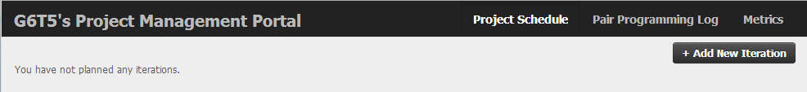
Logging In
Recommend to use Chrome browser
Visit URL http://violet.smu.edu.sg/pplog/
Log in using SMU credentials
You will be forwarded to your team’s Project Management Portal
Make sure you’re in the right team!
Software Engineering

Slide 5
Building your Project Schedule

Slide 6
Building Your Project Schedule
This tool assumes you’re following an iterative process for development
Add your first iteration by clicking
on the button at the top right
hand corner
Result: Your first iteration! (no tasks yet)
Software Engineering

Slide 7
Building Your Project Schedule (cont’d)
Add your first task by entering its details
  Category (optional)
    eg. Development, Admin, UI Design
    Task category/header; good to have
    Case-sensitive when the PM Portal displays categories of tasks
  Task Description
    eg. Slides for PM Review, Bootstrap Logic
    Be specific and detailed (whatever entered will be used to populate PP log’s task description)
  Type
    Code - tasks that require code files to be modified (.java, .jsp, .js, .html, .xml, .properties, and .css)
      Only code-typed tasks are available for scheduling PP sessions
    Non-Code – tasks like doing up PowerPoint slides, wireframes etc
  Start Date and End Date
    Expected (planned) dates
Software Engineering

Slide 8

Building Your Project Schedule (cont’d)
Add your first task by entering its details
  Hours
    Eg 2.5 where 2.5 hrs = 2 hr 30 min
    No thousand separator “,”, eg enter “1000” instead of “1,000”
  Assigned
    Members assigned to the task
    Hover mouse over initials to see full name
  Predecessors
    A Predecessor indicates a dependency
    Eg. If Task 2 has Task 1 as a predecessor, it means task 2 cannot be started unless task 1 is complete
When done, click:
Software Engineering

Slide 9

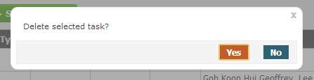
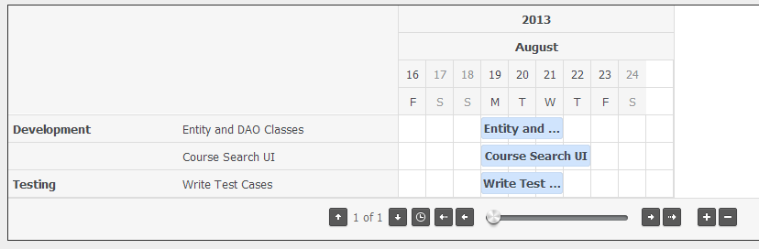
Building Your Project Schedule (cont’d)
You can edit or delete tasks by clicking
You can also view the Gantt Chart for your project
→
Software Engineering

Slide 10
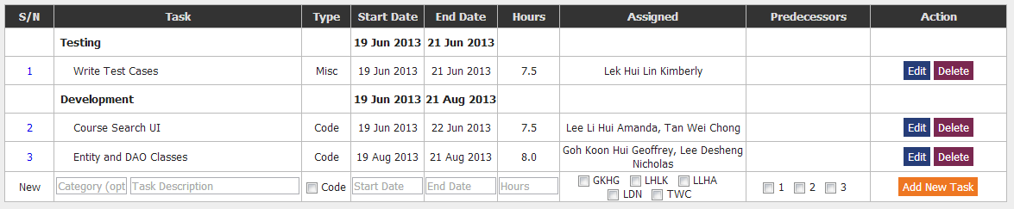

Building Your Project Schedule (cont’d)
Once all your tasks are populated and you are ready to begin work, click
  Note: The Schedule Metric for each iteration is calculated based on the time the first task is started, not the time when the above button is clicked
You may want to plan out all your project iterations first before starting any work
Software Engineering

Slide 11
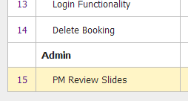
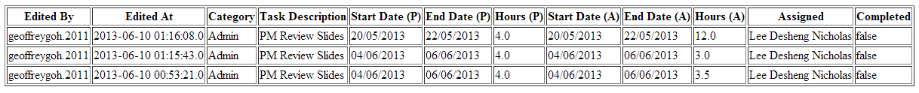
Edit History
Clicking on the task number allows will open a new tab showing you the change history of each task
Software Engineering

Slide 12
Scheduling Pair-Programming Sessions

Slide 13

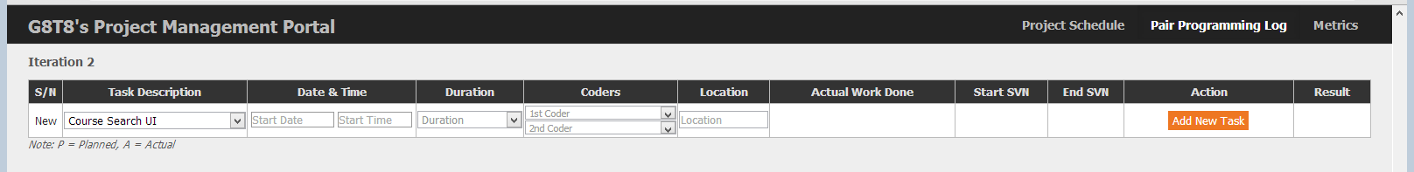
Scheduling Pair-Programming Sessions
To access your Pair Programming Log, click on
in the top right navigation bar
Your (empty) Pair Programming Log looks like this:
Software Engineering

Slide 14

Scheduling Pair-Programming Sessions (cont’d)
To schedule your first Pair Programming Session:
  Enter Task Description
    Select the respective code task from the dropdown
    (populated from items in your Project Schedule)
  Enter Planned Start Date
  Enter Planned Start Time (24 hr format)
  Enter Planned Duration
  Select Two Coders
  Enter Location
Software Engineering

Slide 15
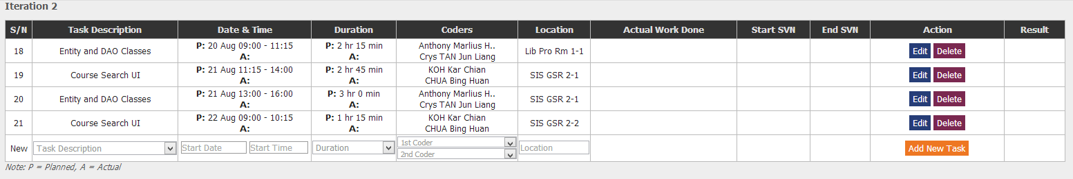
Scheduling Pair-Programming Sessions (cont’d)
After planning out all your Pair Programming Sessions, it should look something like this:
You can plan more than one session to complete one task in the schedule
You can Edit or Delete your planned pair programming sessions
Software Engineering

Slide 16
Updating your Progress

Slide 17
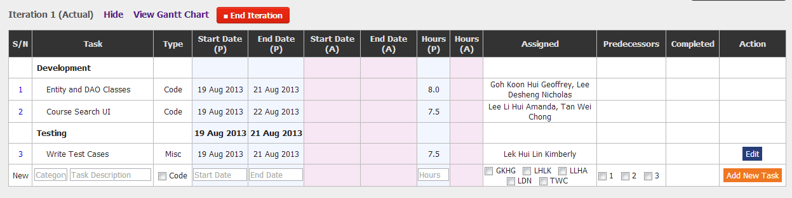
Iteration In-Progress
After clicking , this is how an iteration in-progress looks like:
There are two types of tasks defined by the application, code and misc (non-code) tasks
The process through which you will update progress for these two types of tasks is different
Software Engineering

Slide 18
a. Misc (non-code) tasks
To update your progress for a Misc task, simply click on the button
Update the
  Start Date (A) – Actual Start Date
  End Date (A) – Actual End Date
  Hours (A) – Actual No. of Hours spent
  Completed – Select “Yes” if task completed
Software Engineering

Slide 19
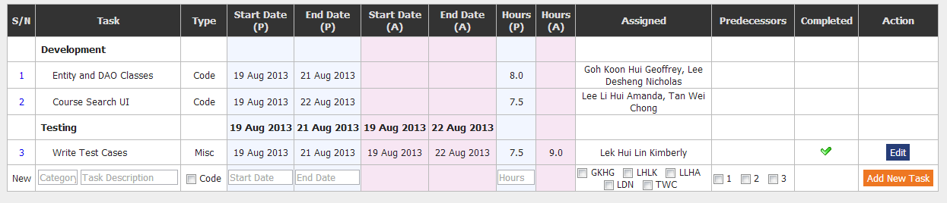
a. Misc (non-code) tasks (cont’d)
Result:
It is a good practice to update the schedule the moment each task is completed
Software Engineering

Slide 20
b. Code tasks
You do not have to directly update your progress into the schedule for a Code task
Instead, the dates/hours are calculated from your Pair Programming Log
To access your Pair Programming Log, click on
in the top right navigation bar
Software Engineering

Slide 21
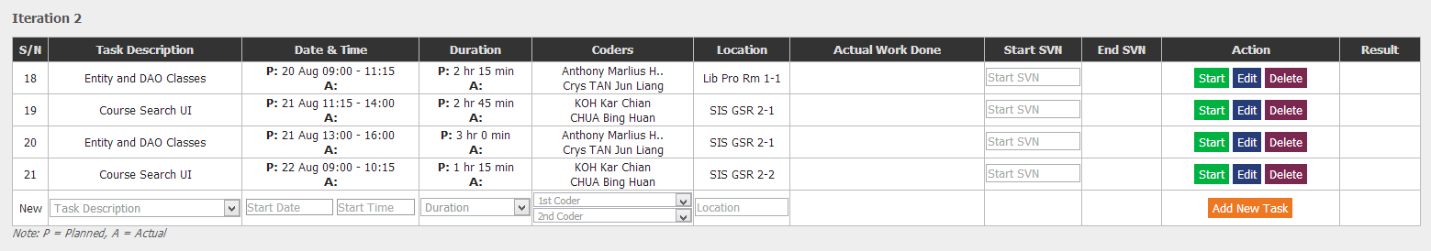
b. Code tasks (cont’d)
The Pair Programming Log is a real-time log, something like a punch-card system
http://en.wikipedia.org/wiki/Timesheet#Time_cards
A programmer logs his time-in and time-out before and after each programming session
Notice that the buttons have changed
  New “Start” button only appears after the iteration has started
Software Engineering

Slide 22
b. Code tasks (cont’d)
See next slide for information on Start SVN & End SVN No.
To clock in your start time for each PP session, enter Start SVN No. and click
The Actual Start Time will reflect the server’s system time when the button was clicked
Result:
The Action column will be replaced with one button which says “Stop”
Software Engineering

Slide 23
b. Code tasks (cont’d)
Start SVN No.
  Before starting a PP session (or any code file commit for a PP session), use SVN Update on your repo folder to synchronize repo file contents
  The Start SVN No. is the revision No. shown on the last line of the dialog box
End SVN No.
  After the last commit for the PP session, use SVN Commit on your repo folder to commit the associated code files of the PP session
  The End SVN No. is the revision No. shown on the last line of the dialog box
Software Engineering

Slide 24
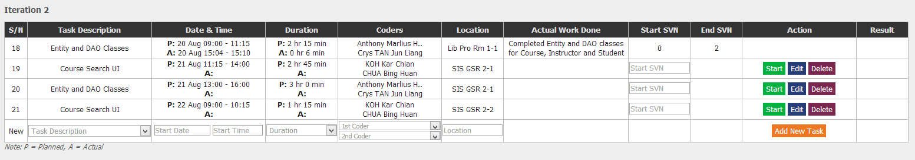
b. Code tasks (cont’d)
After the pair programming session is completed, commit changes to Subversion first
Update the “Actual Work Done” column and Stop SVN No. for the respective sessions before clicking “Stop” within 10 min after the last commit. See also Annex PP Audit slides.
Result:
Software Engineering

Slide 25

b. Code tasks (cont’d)
If you head back to your , you will see the dates and hours for the code task updated accordingly based on the Pair Programming Log
If the code task has been completed, click on
. The green tick will appear beside the item to indicate its completion
Software Engineering

Slide 26
Changes to Original Plans

Slide 27
Ad-hoc Changes
Sometimes, in the middle of an iteration, an unexpected bug or change in scope may occur
Team may decide to deviate from the original plan and add or drop tasks while the iteration is in progress
It would be good to inform your supervisor of such changes!
Software Engineering

Slide 28

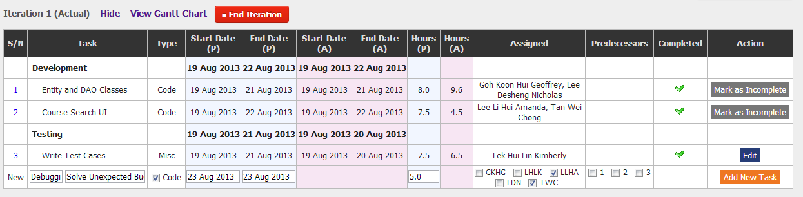
Adding an Ad-Hoc Task
To add an add-hoc, simply input the task details in the last row of the table and click
Software Engineering

Slide 29
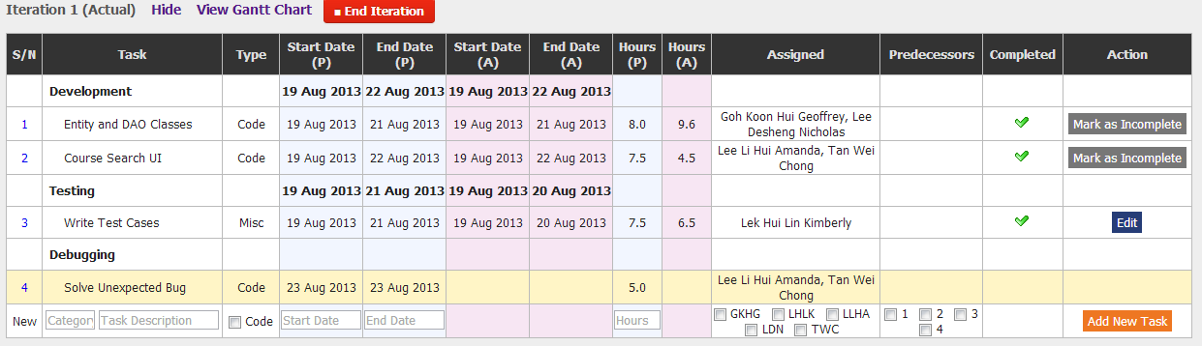
Adding an Ad-Hoc Task (cont’d)
The row corresponding to the new task will be highlighted in orange as it is an ad-hoc task
If it is a code task, team can proceed to schedule pair programming sessions for the task as per normal
→
Software Engineering

Slide 30
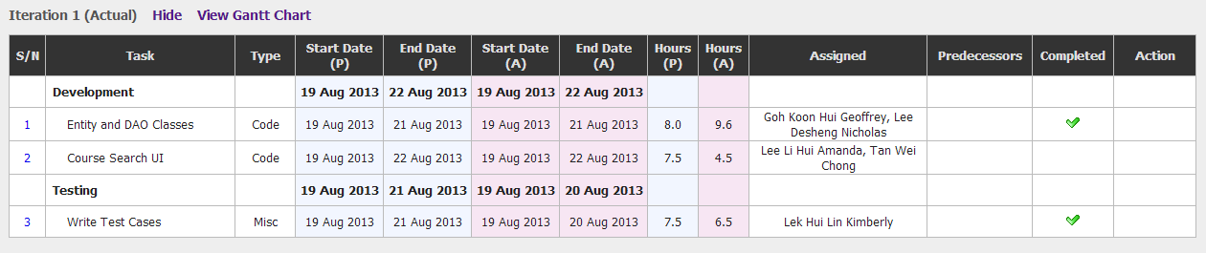
Dropping a Schedule Task
The system does not allow you to remove a planned task once the iteration begins
If a task has been dropped, team should simply leave the actual start/end dates and hours blank, and not mark the item as complete
The system allows you to end an iteration without having all tasks completed
Dropped/ Incomplete Task!
Software Engineering

Slide 31
Ending an Iteration

Slide 32

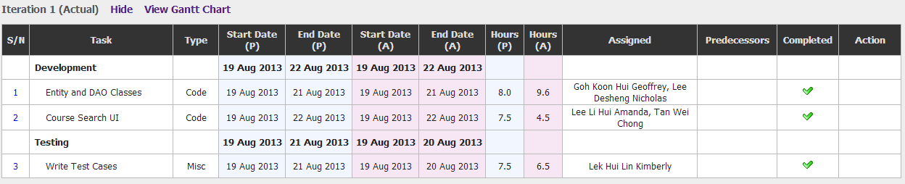
Ending an Iteration
When the team decides to end an iteration, simply click the button
Note: once an iteration is ended, tasks/pair programming sessions can no longer be added or edited
Result:
Software Engineering

Slide 33
Reviewing Team Performance /
Project Metrics

Slide 34
Reviewing Team Performance
It is part and parcel of project management to review the team’s performance every once in a while
Questions you could be asking
  Are our time estimates for each task accurate?
  Are we on track to deliver on time?
  How much time is each member of the team spending on the project each day?
  Is every member receiving a fair share of work?
Software Engineering

Slide 35
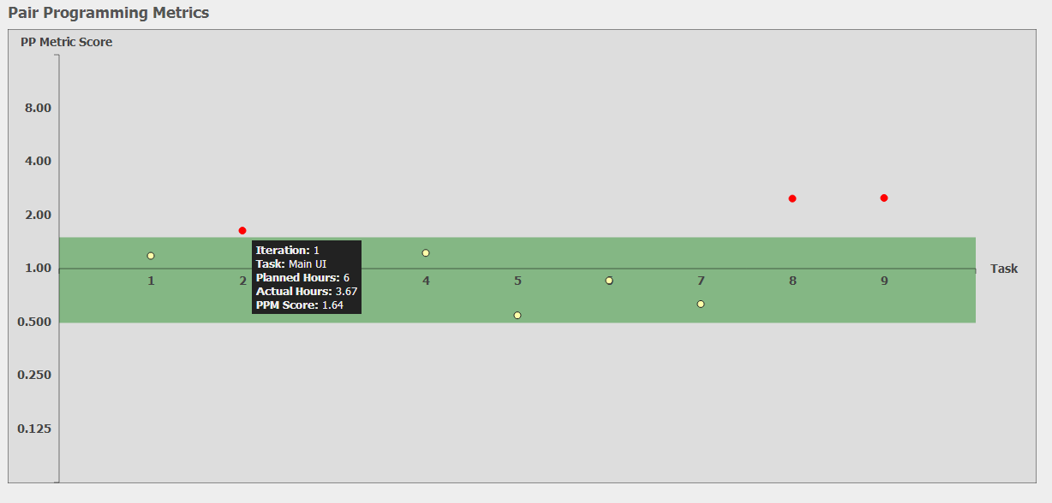
a. Pair Programming Metrics
“Are our time estimates for each task accurate?”
Software Engineering

Slide 36
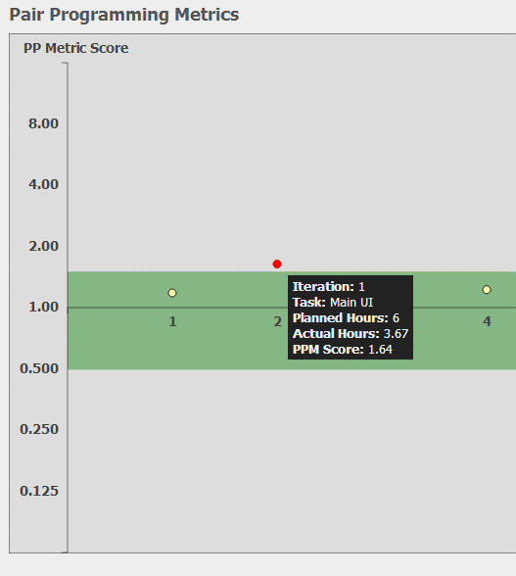
a. Pair Programming Metrics (PPM)
PPM score = Planned/Actual Hours for each code task
The green (safe) zone corresponds to PPM Scores between 0.5 to 1.5
Any code task our of the safe zone is marked with a red point
Hover mouse over each point to view details
Software Engineering

Slide 37
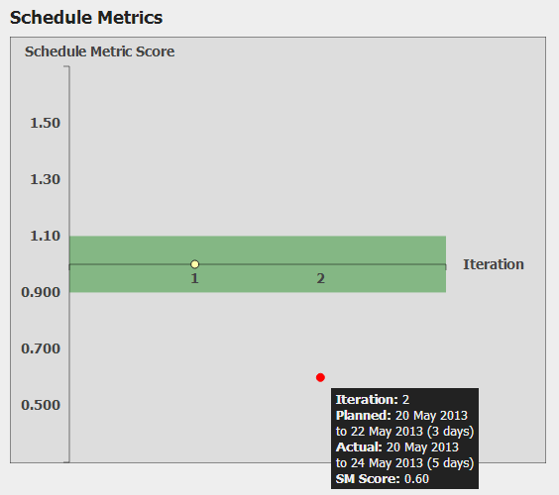
b. Schedule Metrics (SM)
“Are we on track to deliver on time?”
Software Engineering

Slide 38
b. Schedule Metrics (SM)
SM score = Planned/Actual Days for each iteration
The green (safe) zone corresponds to PPM Scores between 0.9 to 1.1
Any code task our of the safe zone is marked with a red point
Hover mouse over each point to view details
Software Engineering

Slide 39
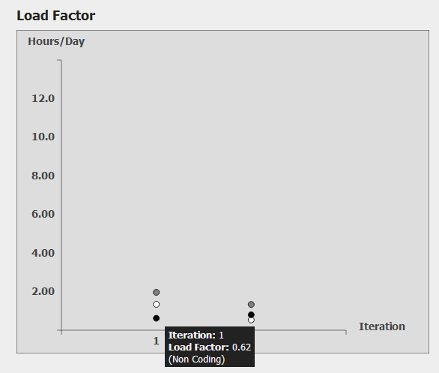
c. Load Factor
“How much time is each member of the team spending on the project each day?”
Software Engineering

Slide 40
c. Load Factor
Black point – Average hours spent per day on non-coding tasks during the iteration
White point – Average hours spent per day on coding tasks during the iteration
Grey point – Average total hours spent per day on any project-related tasks during the iteration
Software Engineering

Slide 41
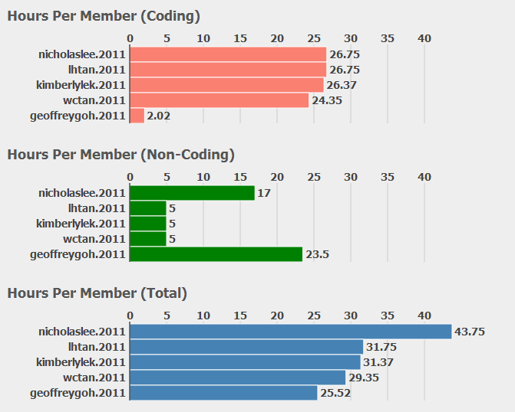
d. Total Hours from each member
“Is every member receiving a fair share of work?”
Software Engineering

